Slide 1
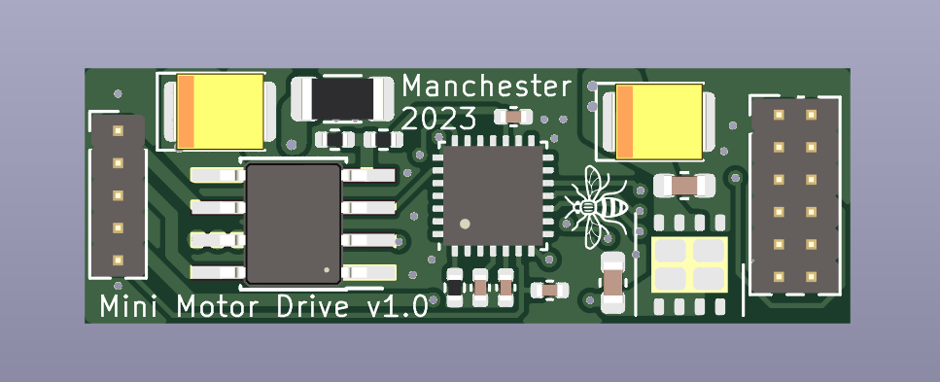
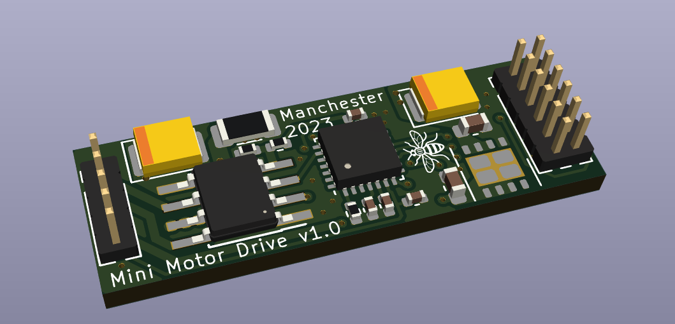
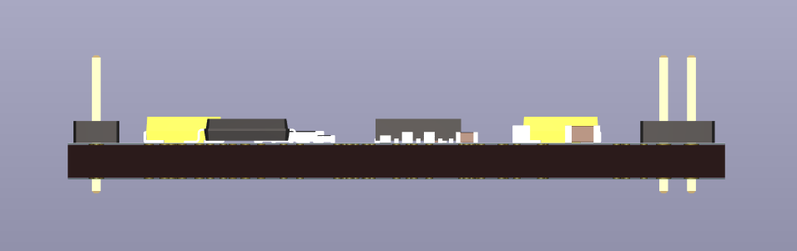
Mini Motor Driver v1.0 – Overview
Gus Zhang <cheng.zhang@manchester.ac.uk> , Aug 2023
Nominal input voltage: 5-18V
Connector pitch: 1.27 mm
3cm
Right Connector (MB)
+12V | +12V
GND | GND
SPI_MOSI | UART_TX
SPI_SCK | UART_RX
SPI_NSS | SWDIO
NRST | SWCLK
Left Connector (FPC)
Motor Drive Out 1
Motor Drive Out 2
GND – Hall Sensor
+3V3 – Hall Sensor
Out – Hall Sensor
1cm

